Slide 1
Drone Phenology Monitoring
Gaurav Rajput
Parth Thakur

Slide 2
Conditional Threshold Matching
Every crown pair within a base radius (base_max_dist) gets per-pair features from _compute_pair_metrics: IoU, overlap ratios, centroid distance, area ratio, geometry containment flags, and a baseline similarity
Low-signal pairs are dropped early via min_base_similarity and overlap_gate

Slide 3
Classification
containment: one geometry fully contains the other.
one_to_one: both crowns overlap strongly and are unique partners.
split / merge: a previous crown overlaps multiple current crowns (split) or vice versa.
partial_overlap: moderate IoU or overlap without strong mutual exclusivity.
proximity: fallback when overlap is weak but centroids fall within a size-scaled radius.
Anything failing all gates is tagged none and removed.

Slide 4
Case Specific Processing
Cases are processed in priority order (one_to_one → containment → split → merge → partial_overlap → proximity).
We have defined a function for match deciding for each of these specific cases
Or we can define specific thresholds and weights for each case and toggle repeating logics on or off(next slide)

Slide 5
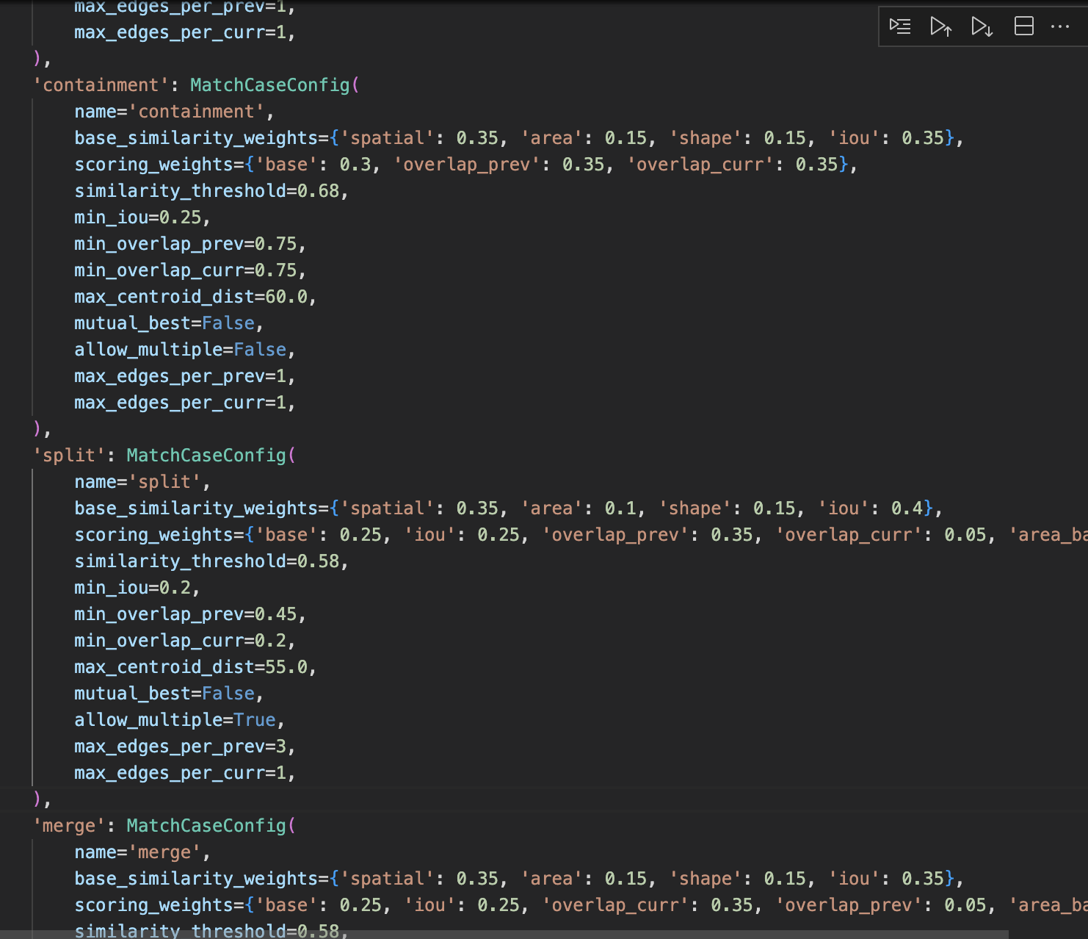

Slide 6
Results
Match Rates by Orthomosaic Pair:
- 1->2: 30/80 (0.375)
- 2->3: 37/116 (0.319)
- 3->4: 57/130 (0.438)
- 4->5: 58/150 (0.387)
Average diameter: 0.378(lots of 0 degree nodes)
Median diameter: 0.000
Max diameter: 7 (Good)
Total edges 192 (low)
one_to_one: 18
split: 52
merge: 29
partial_overlap: 42
proximity: 49
containment: 2

Slide 7
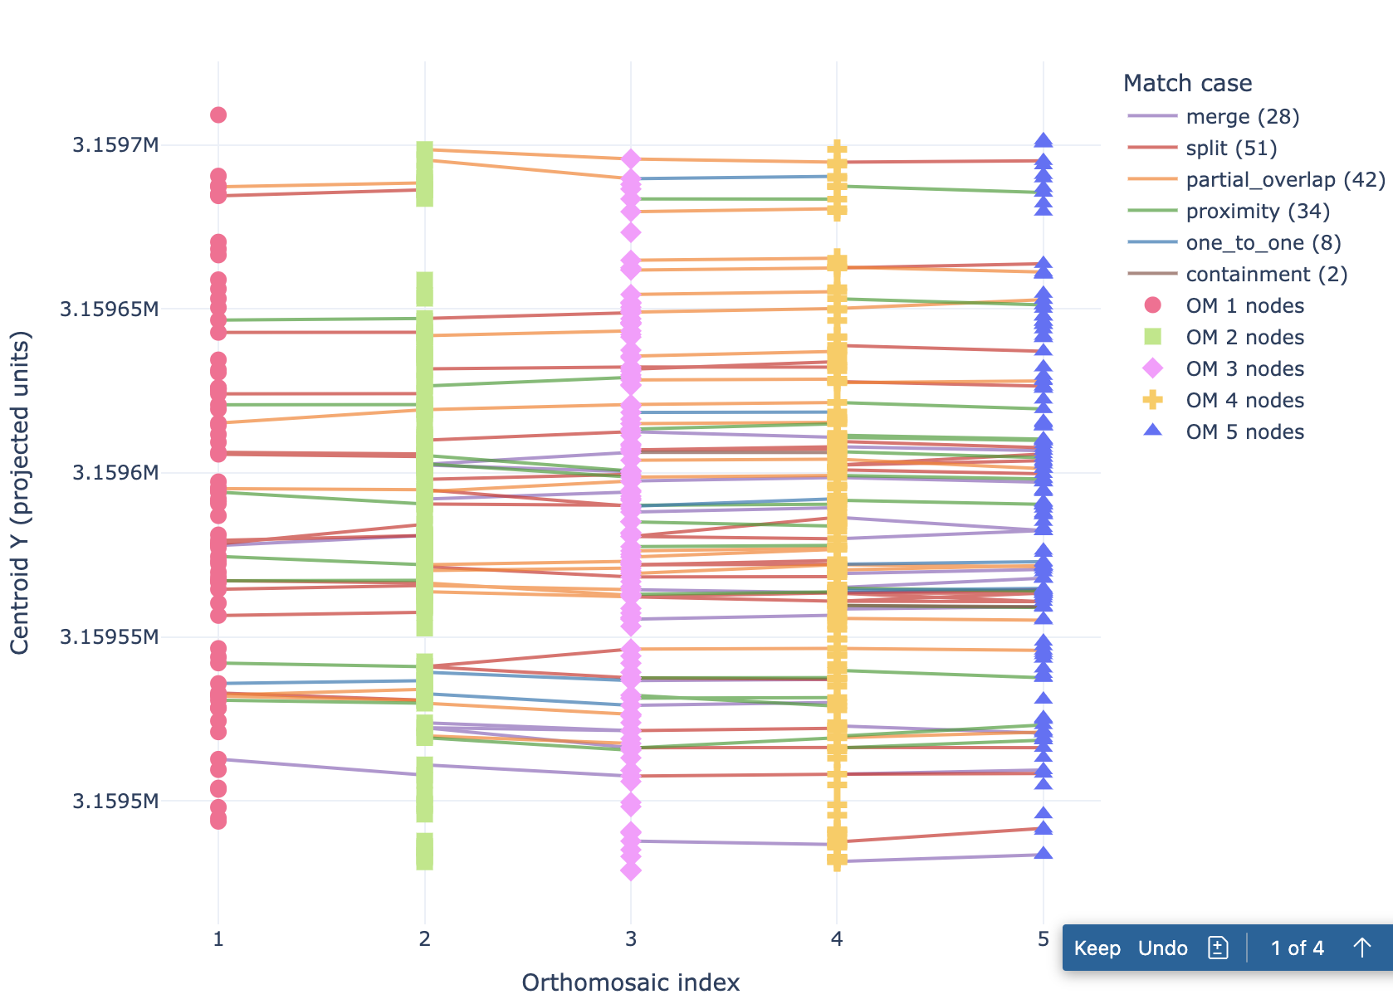
Centroid Projected Visualization

